Slide 1
RDF Schema
Mauricio Espinoza Mejía
mauricio.espinoza@ucuenca.edu.ec

Slide 2
RDF Schema: the language
Properties
rdf:Property
A property can be defined by stating that it is an instance of the predefined class rdf:Property.
Example:
ex:author rdf:type rdf:Property .
Then, property ex:author can be used as a predicate in an RDF triple such as the following:
ex:john ex:author ex:book123 .

Slide 3
RDF Schema: the language
Properties
rdf:Property
Defining a property explicitly is optional; if we write the RDF triple
S P O .
then P is inferred to be a property by RDFS.
Optionally, properties can be declared to apply to certain instances of classes by defining their domain and range.

Slide 4
RDF Schema: the language
Domain and Range: Example
ex:Book rdf:type rdfs:Class .
ex:Person rdf:type rdfs:Class .
ex:author rdf:type rdf:Property .
ex:author rdfs:domain ex:Book .
ex:author rdfs:range ex:Person .

Slide 5
RDF Schema: the language
Domain and Range:
For a property, we can have zero, one, or more than one domain or range statements.

Slide 6
RDF Schema: the language
Domain and Range:
No domain or no range statement: If no range statement has been made for property P, then nothing has been said about the values of this property. Similarly for no domain statement.
Example: If we have only the triple
ex:frank ex:hasMother ex:mary .
then nothing can be inferred from it regarding resources ex:frank and ex:mary

Slide 7
RDF Schema: the language
Domain and Range:
One domain statement: If we have
P rdfs:domain D .
then we can infer that when P is applied to some resource, this resource is an instance of class D.
One range statement: If we have
P rdfs:range R .
then we can infer that when P is applied to some resource, the value of P is an instance of class R.

Slide 8
RDF Schema: the language
Domain and Range
If we have
ex:author rdfs:domain ex:Book .
ex:book123 ex:author ex:frank .
then we can infer:
ex:book123 rdf:type ex:Book.
If we have
ex:author rdfs:range ex:Person .
ex:book1 ex:author ex:frank .
then we can infer
ex:frank rdf:type ex:Person .

Slide 9
RDF Schema: the language
Domain and Range
Two domain or range statements: If we have
P rdfs:range C1 .
P rdfs:range C2 .
then we can infer that the values of property P are instances of both C1 and C2. Similarly, for two domain statements.
Example: If we have
ex:hasMother rdfs:range ex:Female .
ex:hasMother rdfs:range ex:Person .
ex:frank ex:hasMother ex:frances .
then we can infer that ex:frances is an instance of both ex:Female and ex:Person

Slide 10
RDF Schema: the language
Domain and Range
Another Example
ex:Professor rdf:type rdfs:Class .
ex:University rdf:type rdfs:Class .
ex:workAt rdf:type rdf:Property .
ex:workAt rdfs:domain ex:Professor .
ex:workAt rdfs:range ex:University .
ex:mauricio ex:workAt ex:ucuenca .
What new triples can we infer from the above?
ex:mauricio rdf:type ex:Professor .
ex:ucuenca rdf:type ex:University .

Slide 11
RDF Schema: the language
Domain and Range
Another Example
ex:Human rdf:type rdfs:Class .
ex:hasParent rdf:type rdf:Property .
ex:hasParent rdfs:domain ex:Human .
ex:hasParent rdfs:range ex:Human .
ex:tina ex:hasParent ex:john .
What new triples can we infer from the above?
ex:tina rdf:type ex:Human .
ex:jhon rdf:type ex:Human .

Slide 12
RDF Schema: the language
Domain and Range: Datatypes for Ranges
The rdfs:range property can also be used to indicate that the value of a property is given by a typed literal.
Example:
ex:age rdf:type rdf:Property .
ex:age rdfs:range xsd:integer .

Slide 13
Example
professors are academic_staff_members
modules are taught by academic staff members only
Is taught by is a subproperty of involves
Semantic Web is a module and Michael Zang is a proffesor

Slide 14
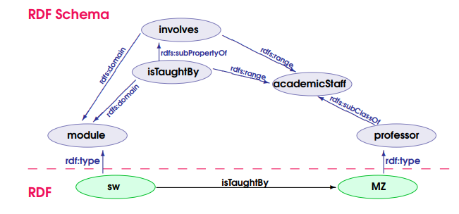
RDF vs. RDFS layers
What ‘implicit knowledge’ is missing in the picture

Slide 15
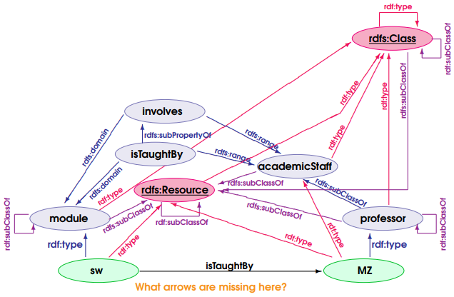
RDFS Semantics

Slide 16

Preguntas?

